Slide 1

Image
Compression

Slide 2
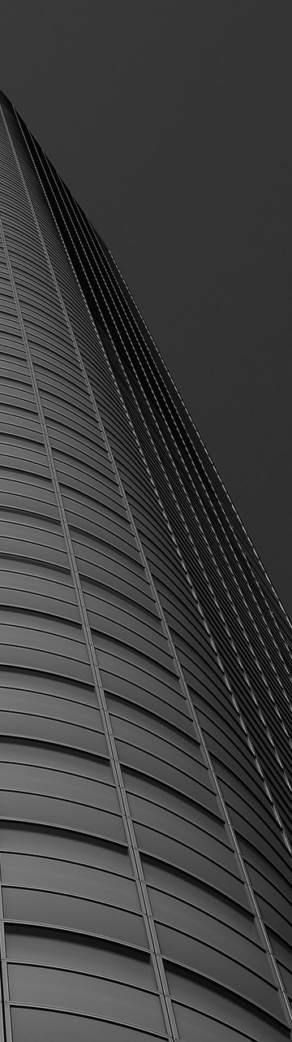

what is a
Image Compression?
Reducing the size of a digital image file
Preserve its visual quality to the greatest extent possible.
Primary Goal : Save storage space and improve the efficiency of image transmission over networks while minimizing the loss of important visual information.

Slide 3
Why
Deep Learning?
Traditional image compression methods like JPEG and JPEG-2000 rely on specific algorithms that leverage mathematical transformations and coding techniques to reduce file sizes while attempting to retain image quality.

Slide 4
The deep learning-based approach described in the leverages neural networks algorithms, such as MLPs, autoencoders, and GANs, to explore more adaptive, data-driven, and potentially efficient ways of compressing images. These models aim to provide competitive compression rates while maintaining or improving image quality. They learn directly from the image data, allowing for more adaptive and potentially superior compression strategies.

Slide 5
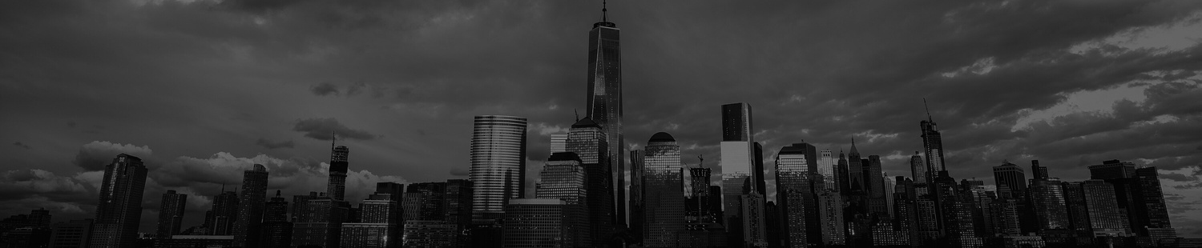
Types of Compression
Lossless Compression
Develop predictive coding methods based on MLP networks to achieve better compression without quality loss.
Lossy Compression
Explore autoencoders and GAN architectures for lossy image compression with minimal information loss.

Slide 6
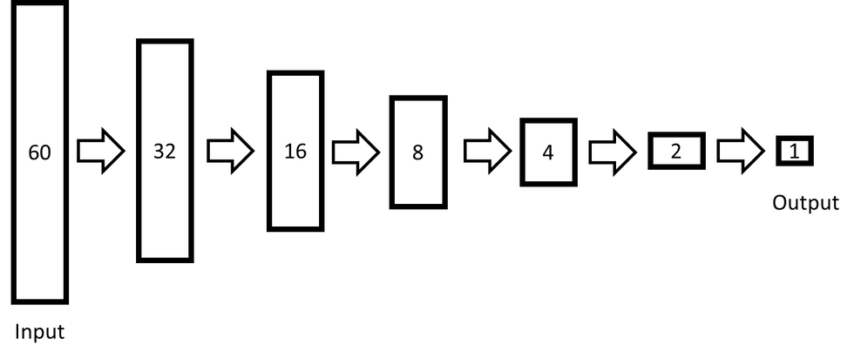
Layers of MLP. We used ReLU functions after every layer.

Slide 7
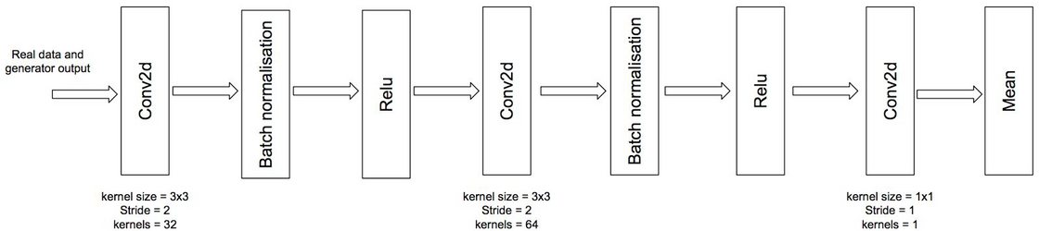
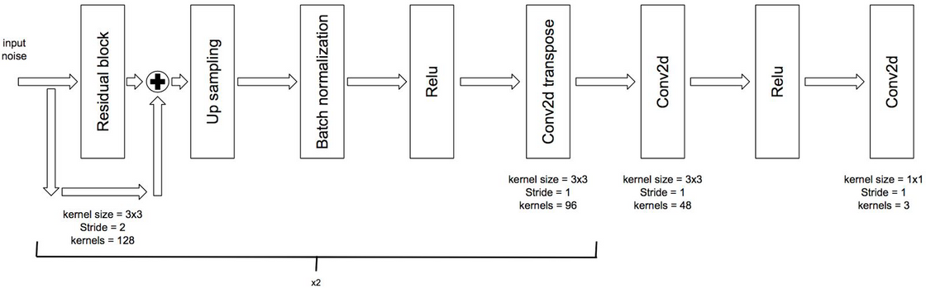
Compression archive using combination of both autoencoder and GAN.

Slide 8

Method
Huffman coding
Predictive coding
Linear regression
RELU function
MLP

Slide 9
Method
CNN-AE
CNN-RNN-AE
CNN-RNN-FT
Autoencoder

Slide 10
Method
CIFAR Dataset
Unsampling
Convolutions oprations
Kernel Size
Stride
Kernel
GAN

Slide 11
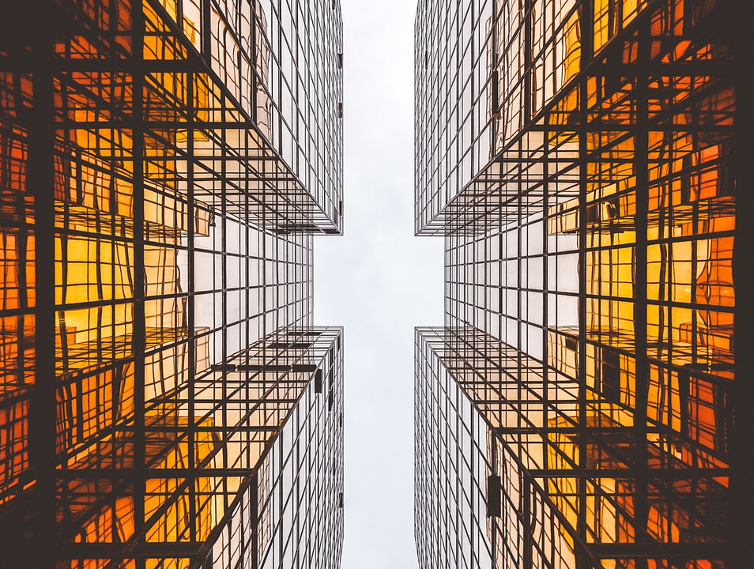
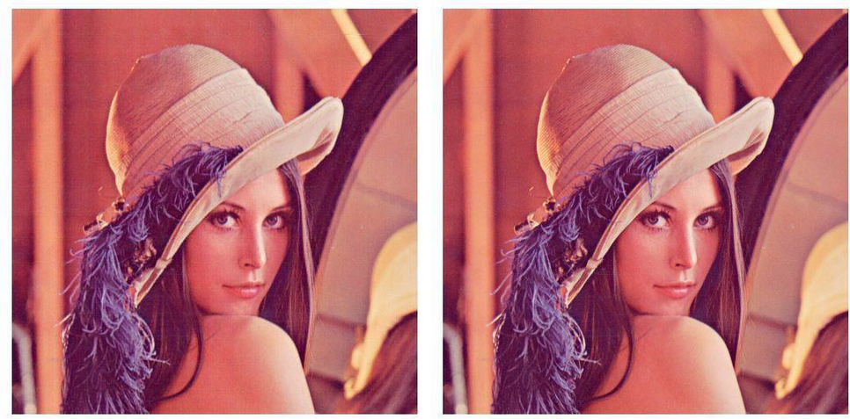
Best performing algorithm(CNN-AE-FT) (Right) and its Original Image

Slide 12
Algorithm | Bit per pixel
JPEG | 5.2
JPEG-2000 | 4.3
MLP | 4.5
Comparison of Average Bits per Pixel Rates for Lossless Compression Algorithms on Test Images

Slide 13
Method | PSNR
JPEG-2000 | 43.6f
GAN-AE(L2,W) | 36.98
GAN-AE(L2,DC) | 31.54
CNN-RNN-AE | 31.4
Results of VariousArchitectures on CIFARDataset

Slide 14
Method | PSNR | SSIM
JPEG-2000 | 36.1 | 0.993
CNN-AE-FT | 33.9 | 0.99
GAN | 32.53 | 0.987
JPEG | 33.2 | 0.986
CNN-RNN-AE | 30.2 | 0.972
Results of VariousArchitectures on HR Dataset

Slide 15
thank you!

